Slide 1
Getting started with yolov5 for inference
David Novikov

Slide 2
Agenda
Overview of ML pipeline
Problem statement
Deployment
Setup
Tutorial

Slide 3
Overview and Problem Introduction

Slide 4
ML pipeline
Data
Model
Define Problem
Define Solution
Training
Deploy
What?
Why?
Appropriate?
How?
Integration
Today
Evaluate - Redo

Slide 5
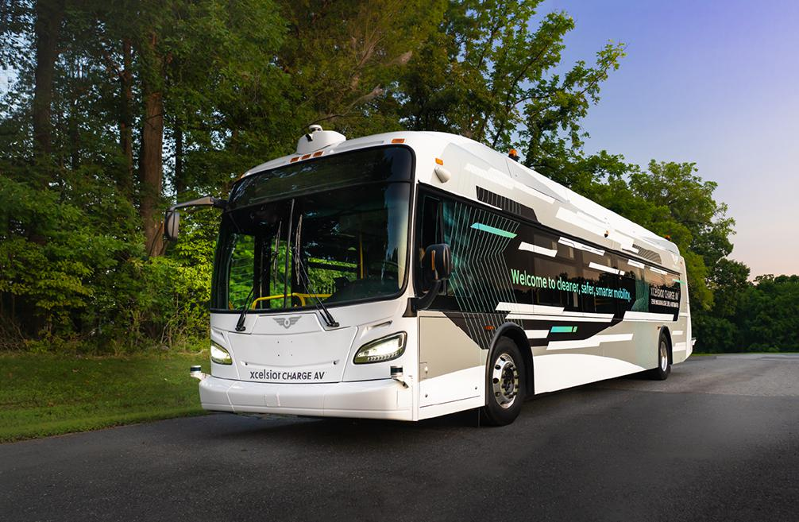
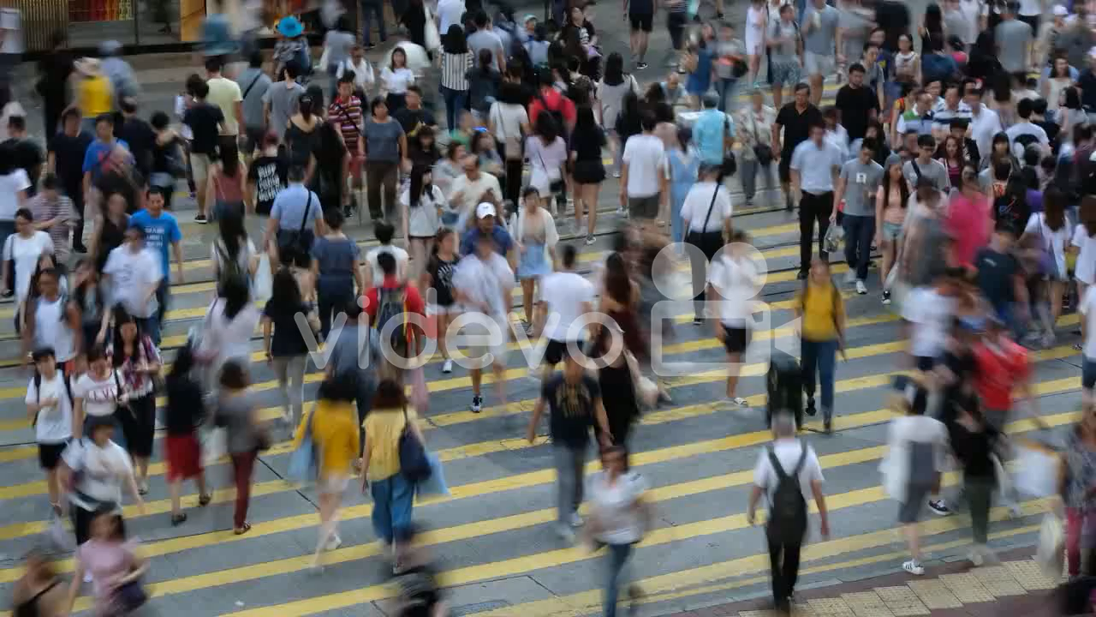
Problem Statement
You work for mayor’s office
New busline
No drivers – fully autonomous
Problem: Buses can’t detect if people are crossing intersection
Your job to solve in the next ~30 min

Slide 6
What are we doing today?

Slide 7

Deployment
Today we will be using yolov5 as the ML part of our solution
We will focus on integrating out of the box ML models into a solution
Why Yolov5?
Easy to use
Python friendly
Pretrained models

Slide 8
Setup and Tutorial

Slide 9
Setup
Open terminal
Set up a new folder
Set up new python environment (python venv, conda, etc.) with python 3.8
Clone yolov5 from github
https://github.com/ultralytics/yolov5

Slide 10
References
https://imageio.forbes.com/specials-images/imageserve/60133a2ba868b9dc5ec5f82d/0x0.jpg?format=jpg&width=1200

